Slide 1
The Place Matters
How to encourage cultural interactions
through study abroad ​
Presenters: Prof. Jessica Sparks, Assistant Professor, Journalism Mass Communications Department Prof. Melanie Smith, Study Abroad Coordinator, Adjunct Instructor
Savannah State University

Slide 2
Planning
Diversity exposure to students
Journalism industry lacks African-American reporters
Focus on reporting
Syllabi required for study abroad application
Met with La Voz Latina editor about location and publication needs

Slide 3
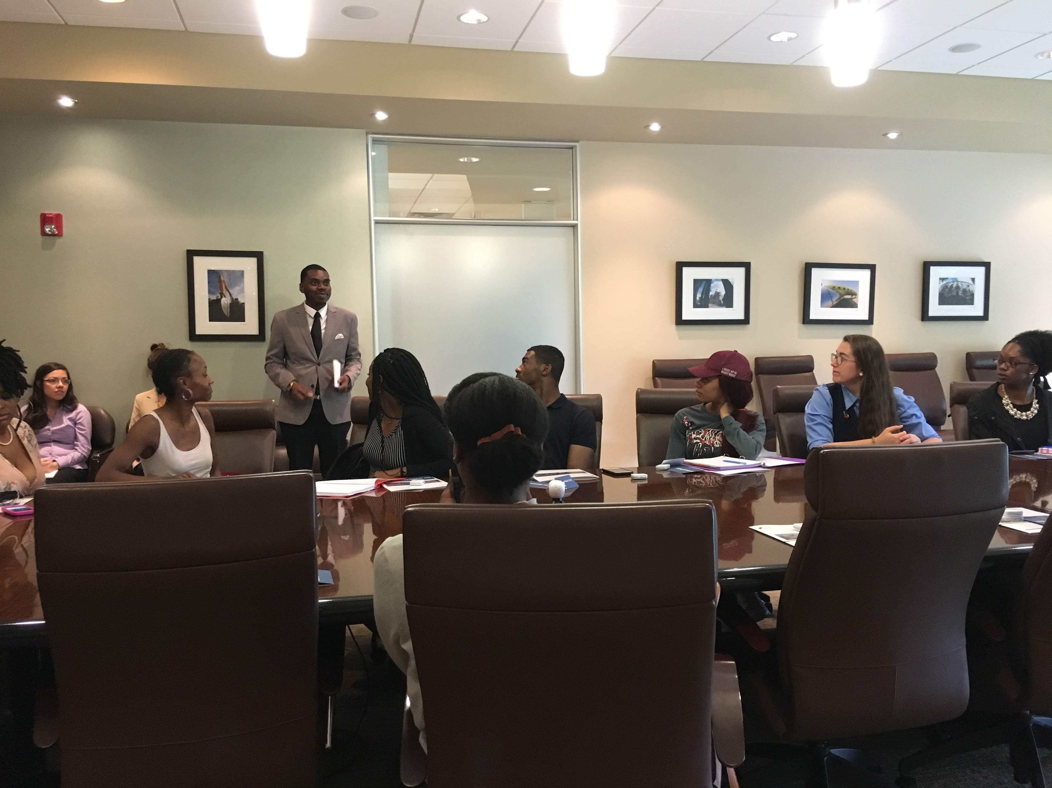
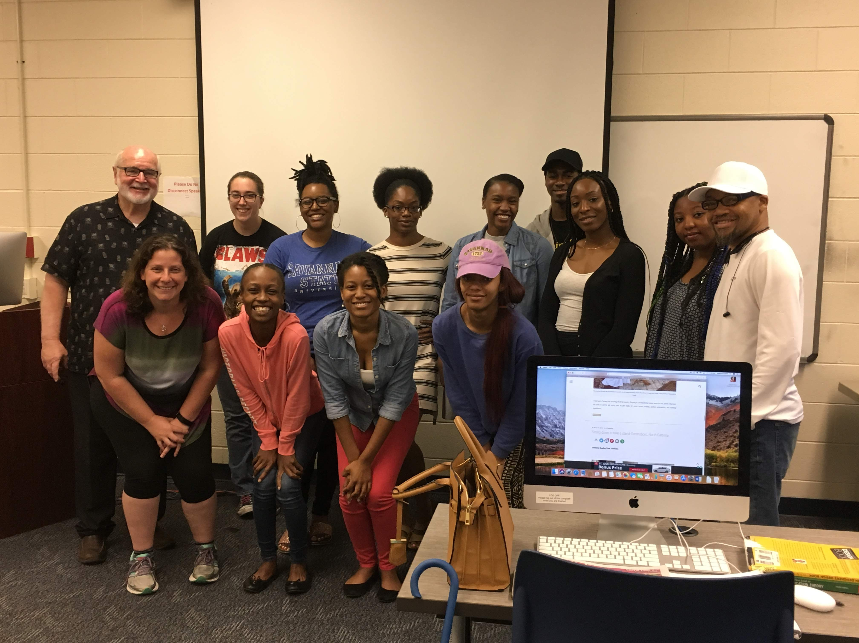
Community Engagement
Learning objectives for the courses were updated to integrate Panamanian culture
Incorporated La Voz Latin, La Isla magazine and Charleston Business Journal
Members from each periodical met with the class prior to departure
Two Panamanian natives visited with the students to discuss issues facing the citizens
Visited Georgia Ports Authority for an overview of logistic operations and connections made with the Panama Canal

Slide 4
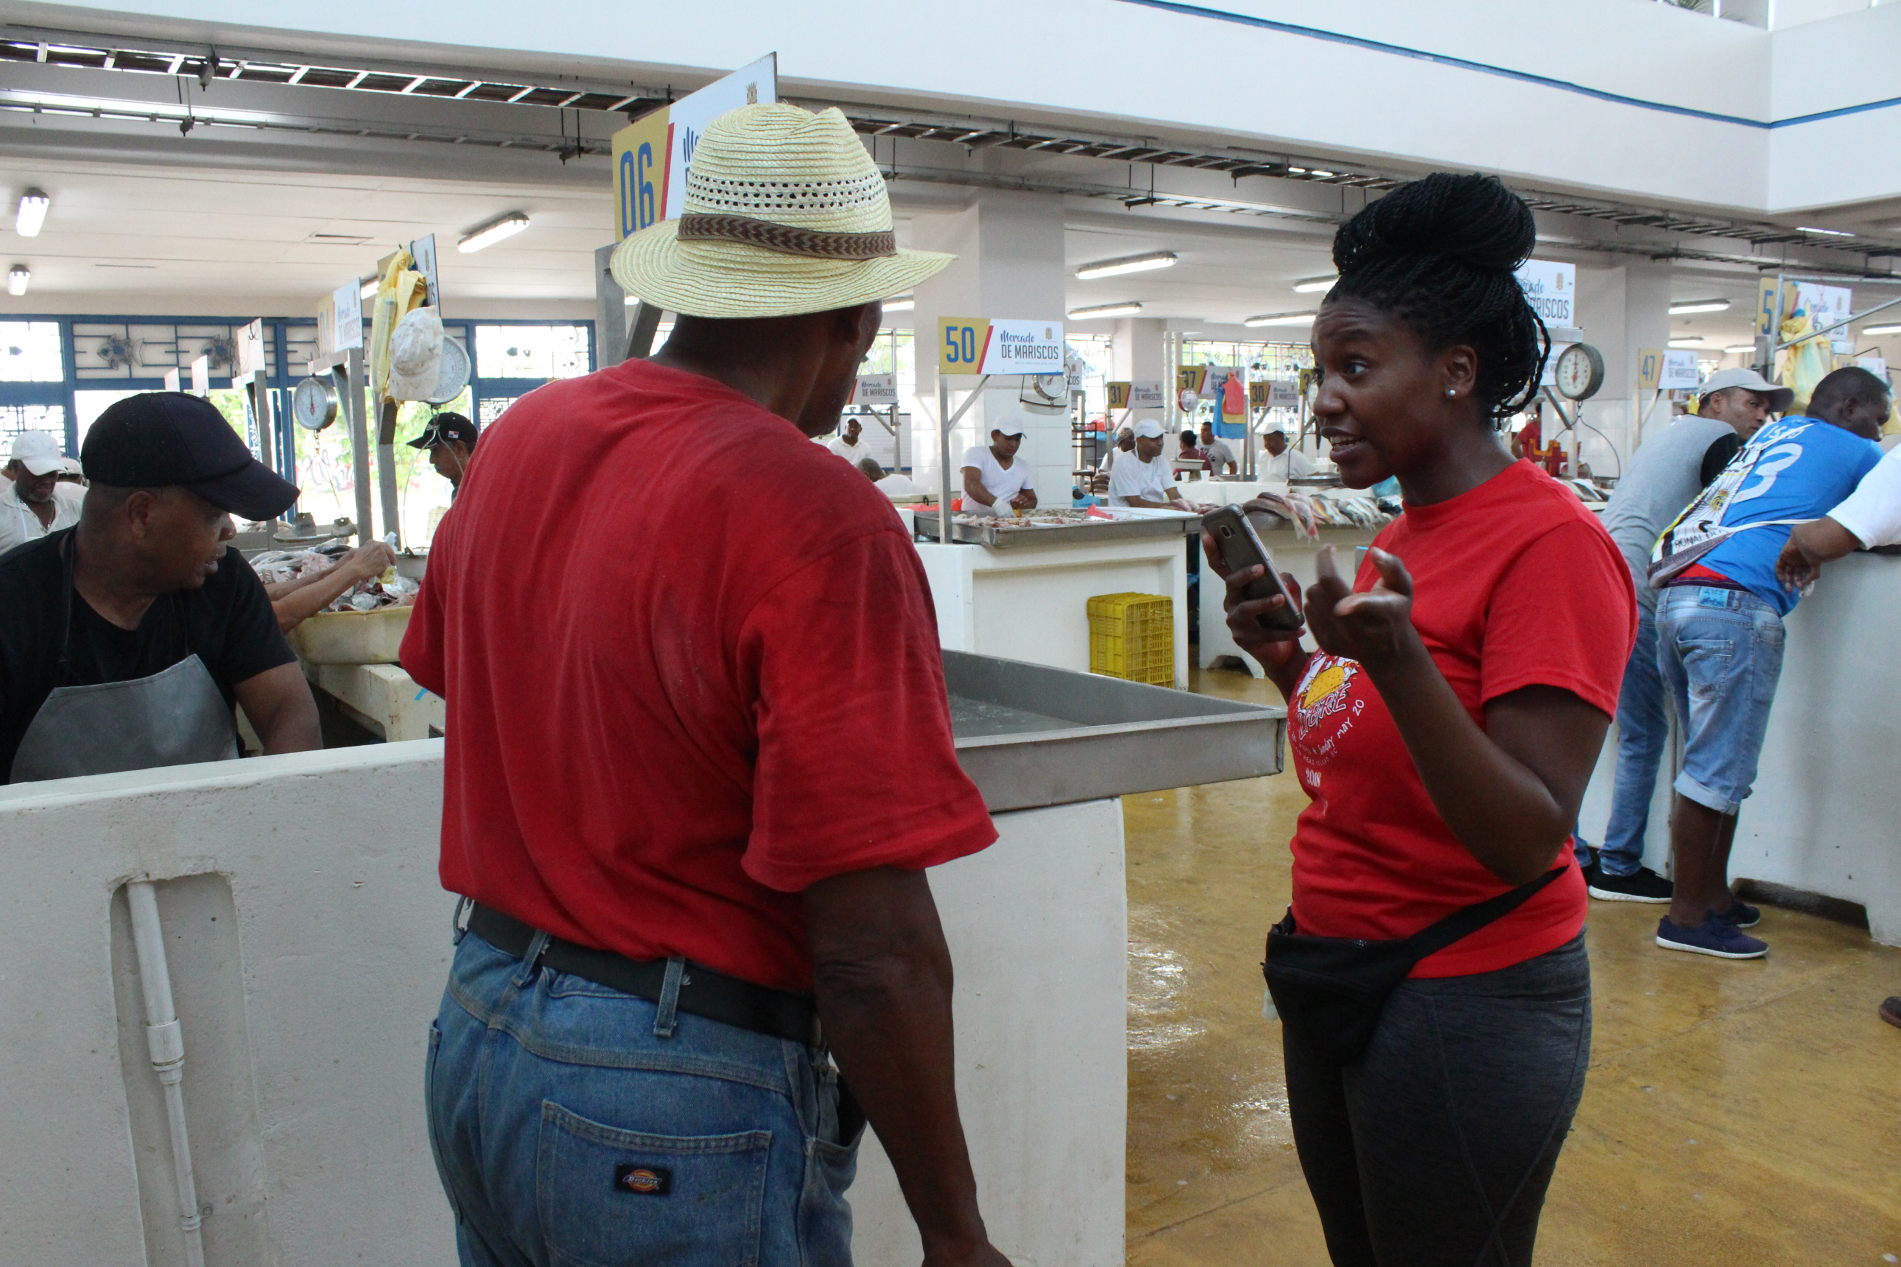
Class Structure
Class was four weeks- two weeks in Savannah, two weeks in Panama
Students were prepared to report on issues important to Savannah media outlets
Upper-level students submitted two long-form journalistic stories upon completion of the trip
Lower-level students submitted an event story, a man-on-the-street video, a trend story, and an enterprise story

Slide 5
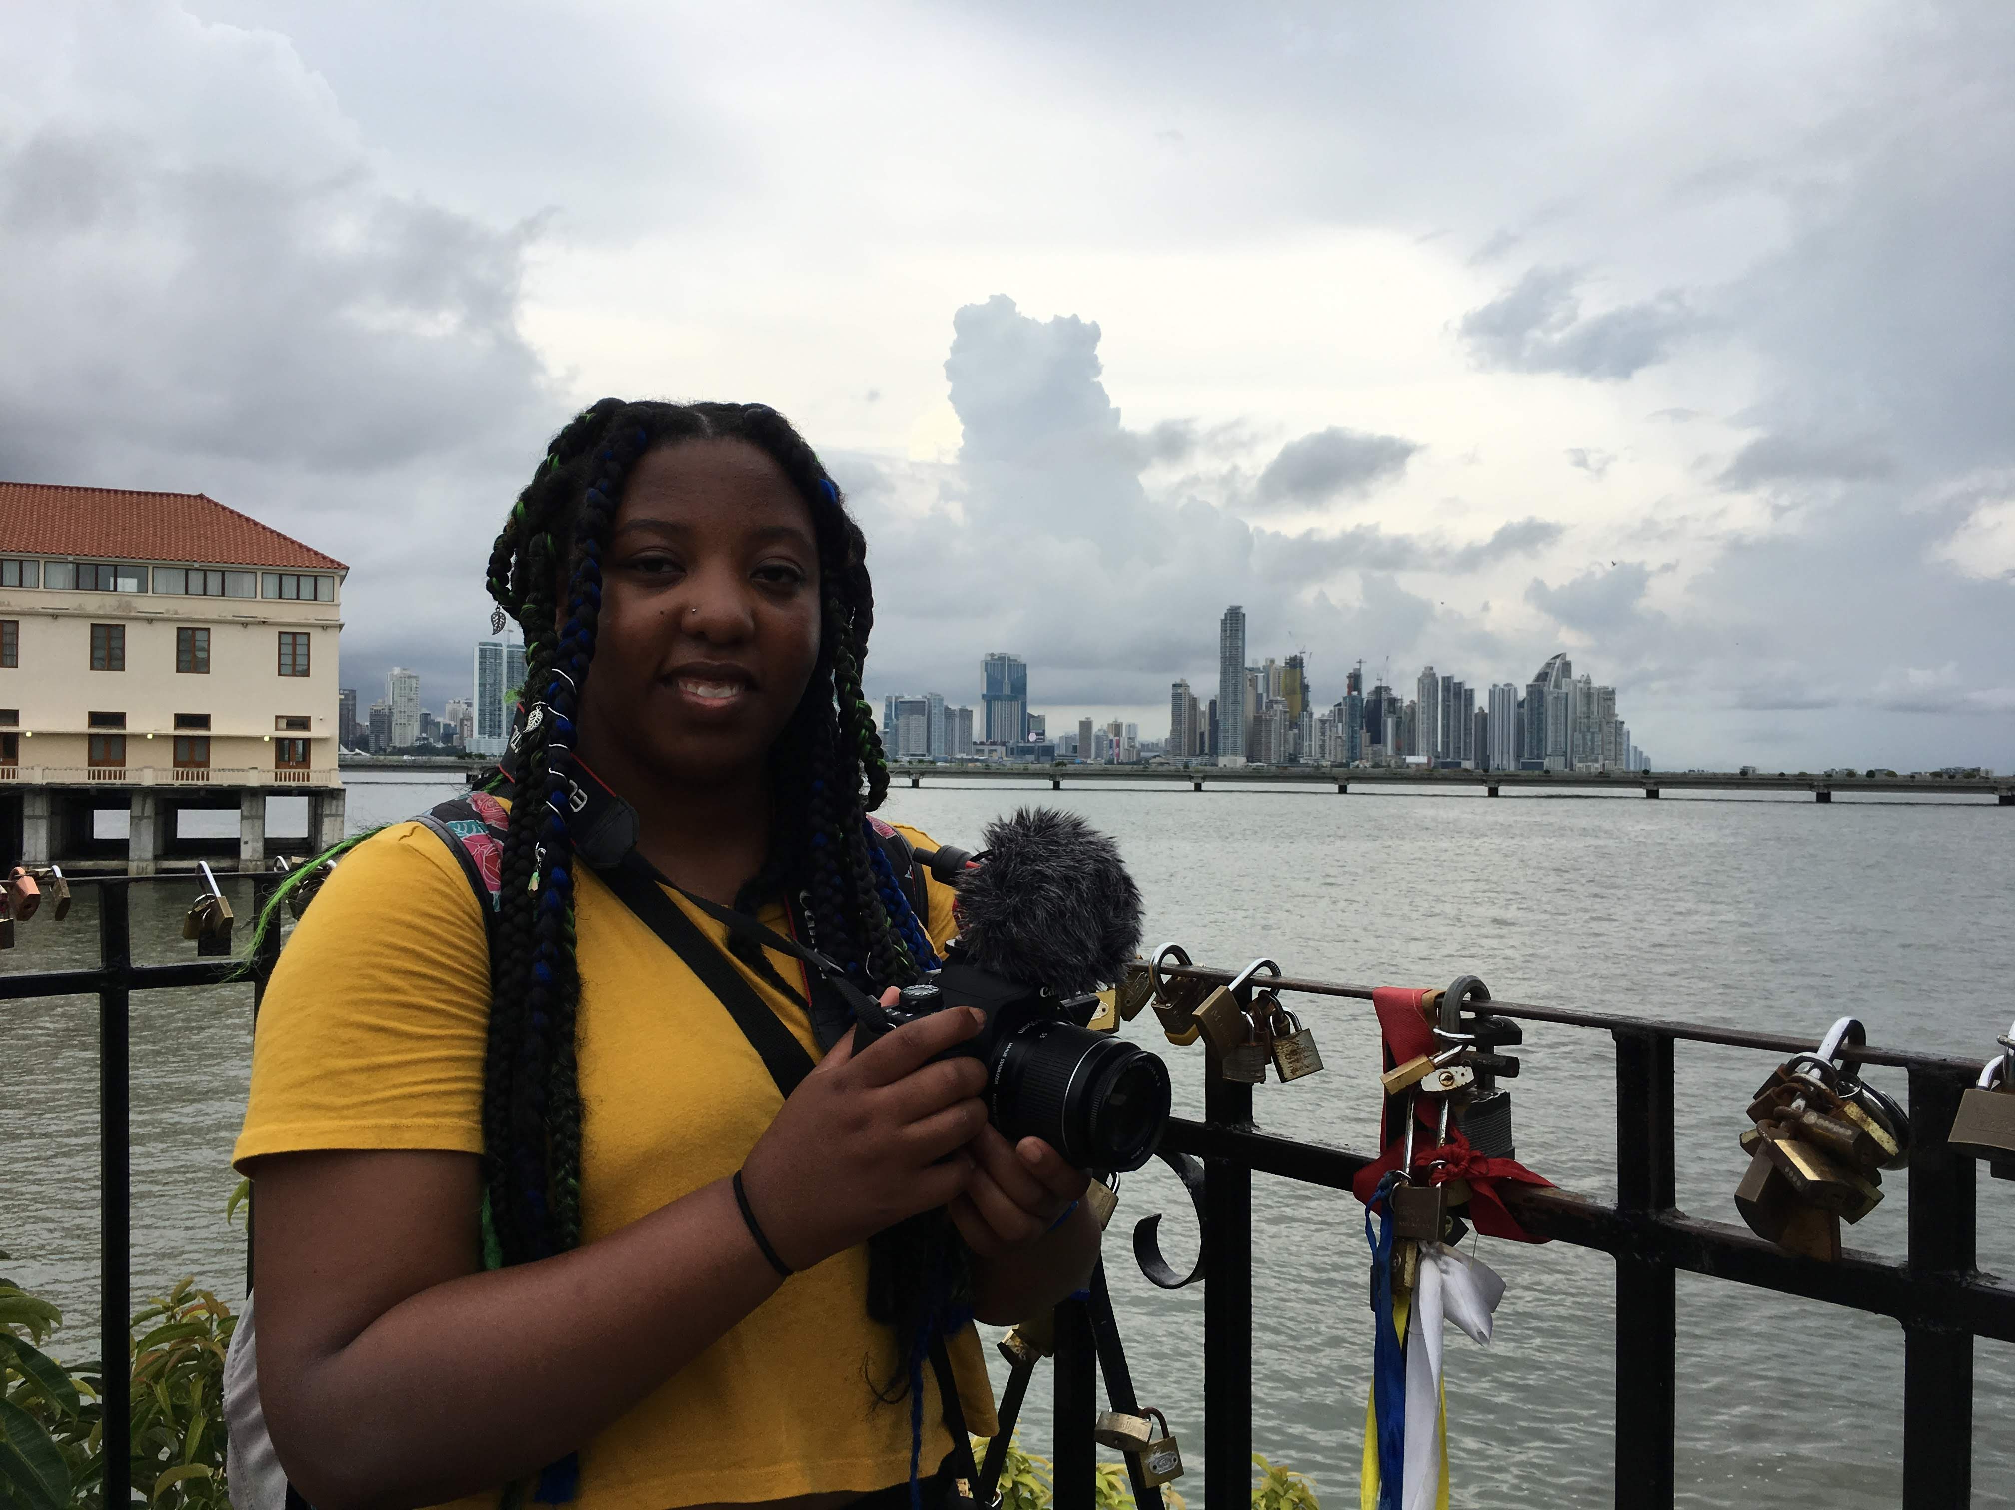
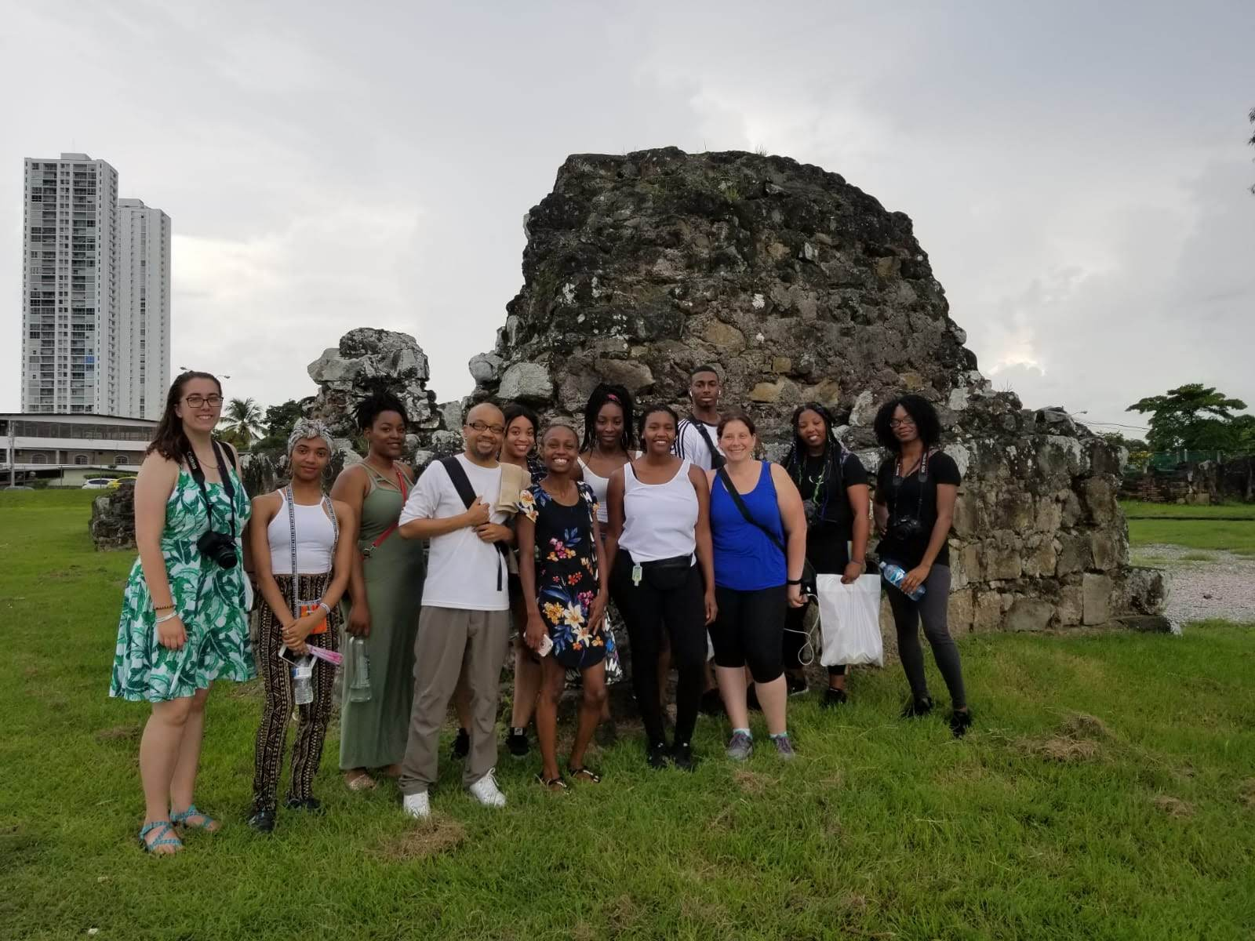
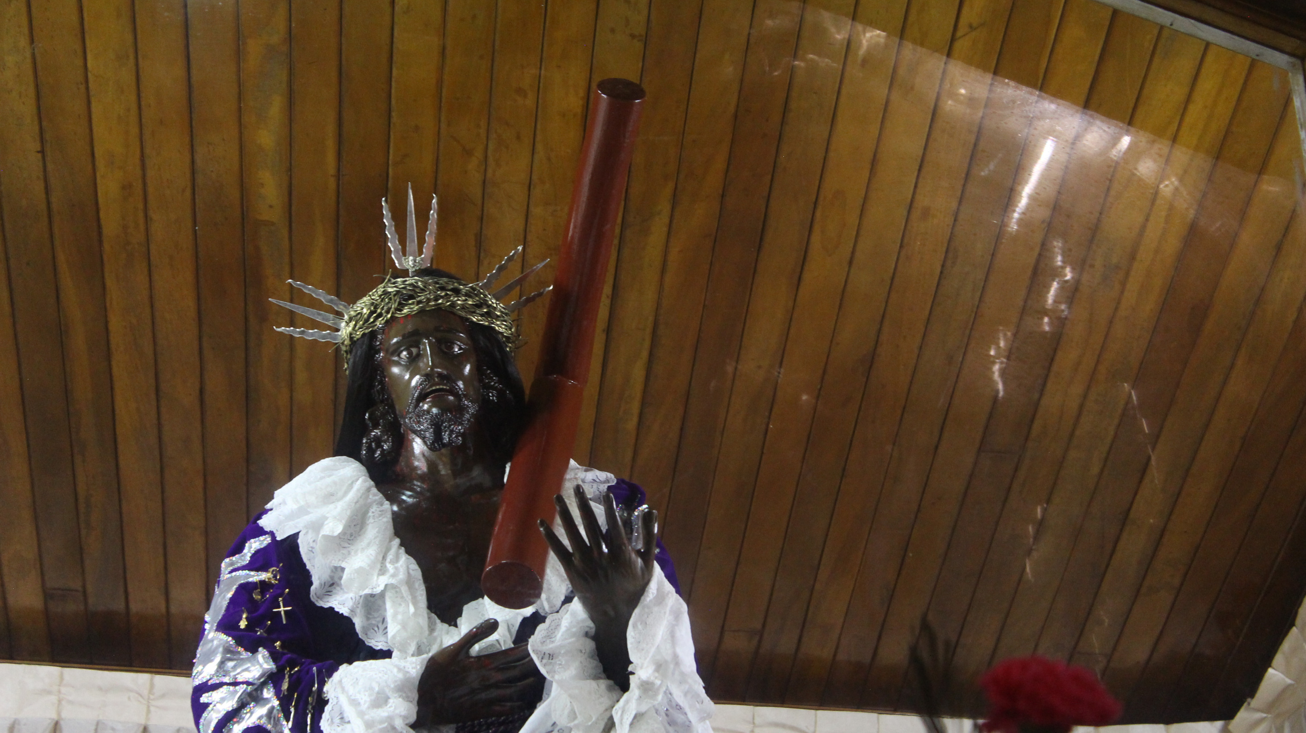
Trip
Students generated story ideas based on independent discovery and critical thinking
Students interviewed community members
Most interviews were conducted in Spanish
Students were required to submit blog posts daily regarding their work and exploration
Cultural activities and tourism were part of the course structure, meeting globalization requirements and aiding in finding story ideas and sources
Housing accommodations were selected to provide students exposure to locally owned businesses and other international travelers

Slide 6
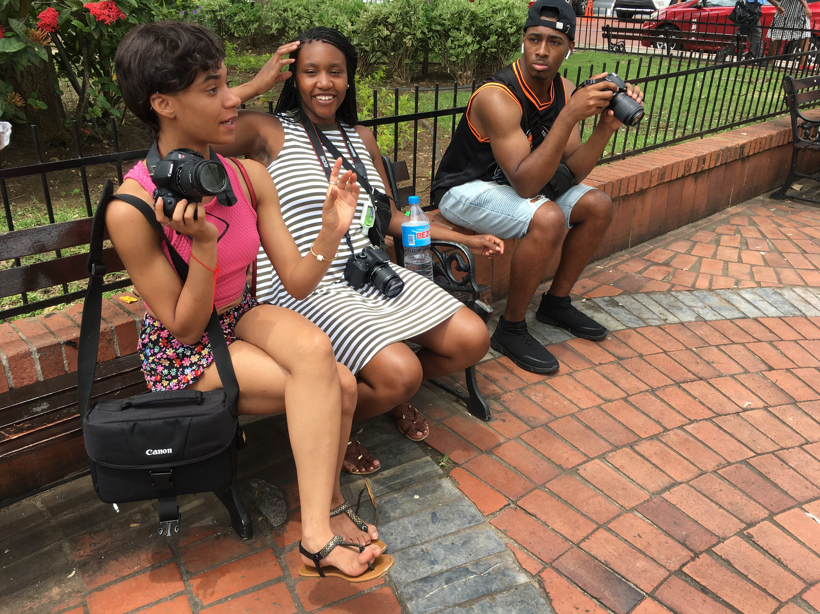
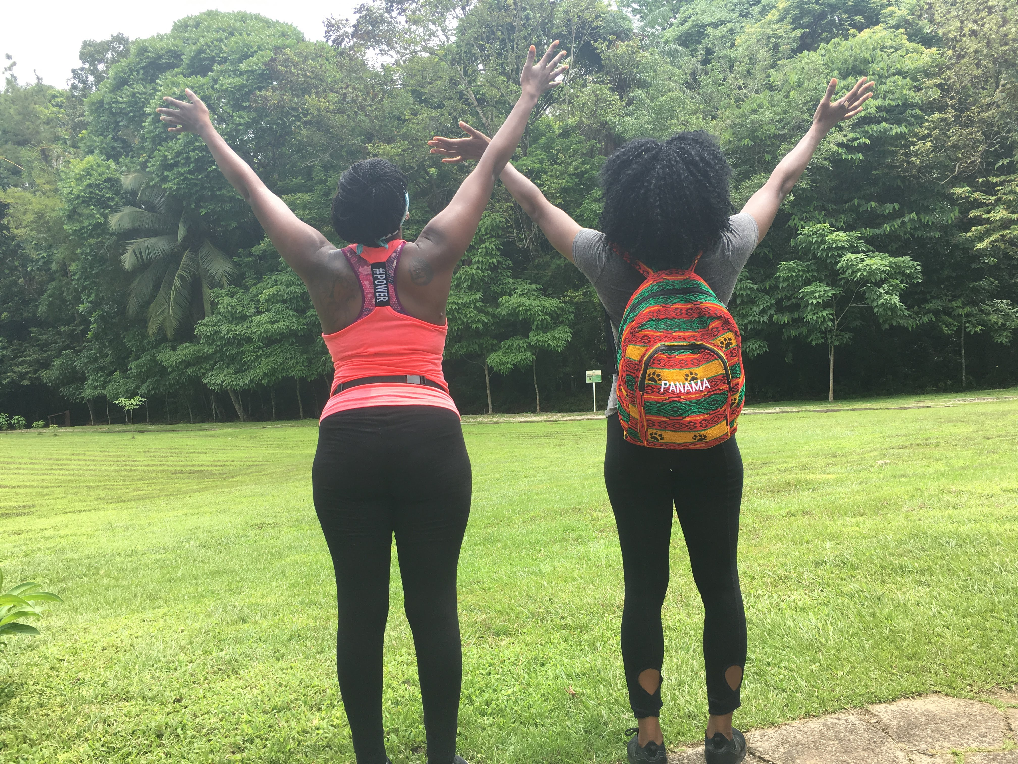
Results
Interviews
Students indicated cultural interaction was heightened due to assignment structure
Found added value in local partnerships
Gaining understanding of an underserved community increased publication strategy
"Being uncomfortable" influenced student growth, personally and professionally
Interaction with the learning objectives happened daily, increasing student understanding

Slide 7
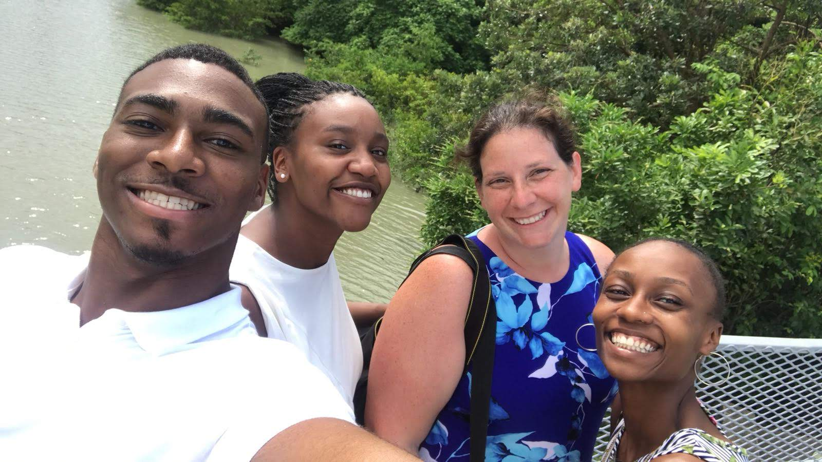
Testimonials
"It helped me get out of my comfort zone a lot and when we went to Panama, it helped us be ready for the things that they were looking for as far as the Latino magazine. But also to get a little bit of background about the culture that we really didn’t know about. And they also came and talked to us about story structures and stuff, so yeah, I thought it was helpful."
"I don’t think I would have tried as hard to get published if I didn’t go to Panama. The place that published me actually was one of the magazines I worked with so I don’t think I would have had that same opportunity if I didn’t go to Panama."
"I’m going to agree with that one because when I, it was only because of my reflection piece that I wrote for Prof. Sparks’ class that got me published by The Mighty so I don’t think I would have gotten, I don’t think I even would have been close to being published by them, or really anybody else had I not gone."
"I would say, that any location would not have had the same effect of studying abroad in a different country because there’s that language barrier. Because when we came back from Panama, it was like, I told everybody, at this point I can do anything because once you get past that language barrier and once you get past that comfort zone because that was my hardest problem reporting in Panama was getting past that language barrier, my topic – thinking it was taboo – and just being confident in my writing. And so this trip has made me confident in my writing because I did this huge thing, and then I got it published, so now I feel like, I can actually do this, I’m a journalist, I’m about to graduate, so yeah!"

Slide 8
Results
When compared to previous semesters of the same courses:
Learning Outcome | Previous Semester | Summer 2018 Results | Percent Change
Research & Source Evaluation | Spring 2017: 2.6/4 average | 3.04/4 average | +16.92%
Written Communication | Spring 2017: 2/3 average | 2.12/3 average | +6%
Use of Industry-Standard Tools | Fall 2016: 2.7/4 average | 3.56/4 average | +31.85%
When compared to previous semesters of evaluation:
Learning Outcome | Previous Assessment | Summer 2018 Results | Percent Change
Domestic Diversity | 2.5/4 average | 3.28/4 average | + 31.2%
Global Diversity | 2.22/4 average | 3.17/4 average | + 42.8%

Slide 9
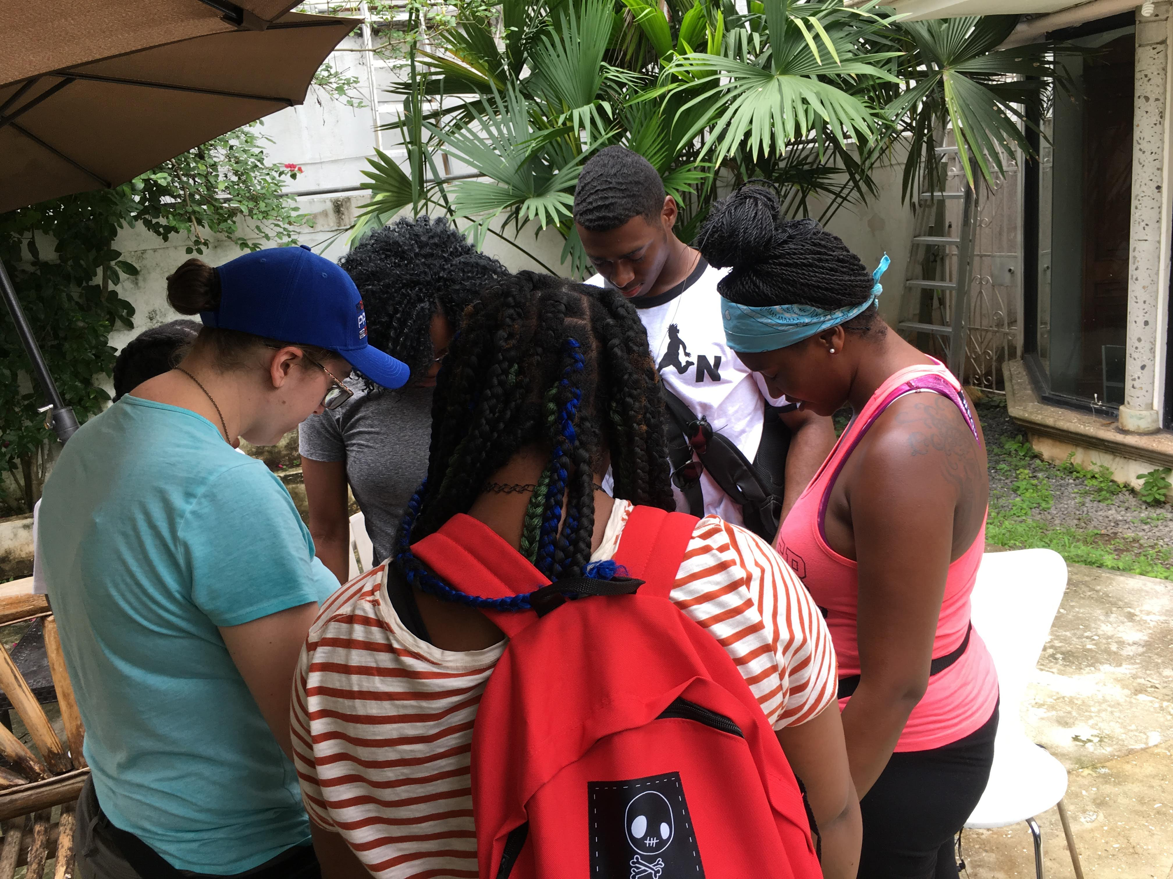
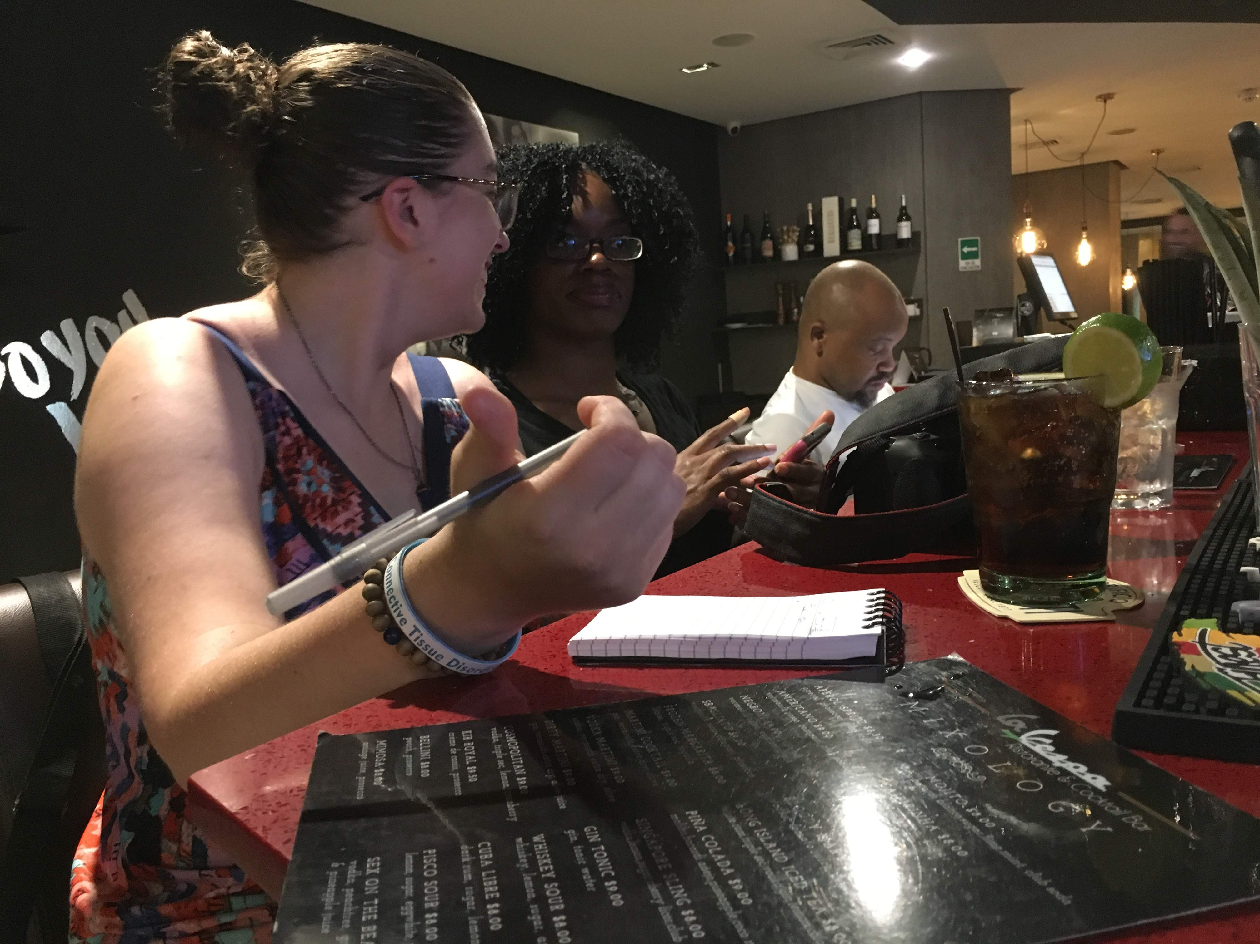
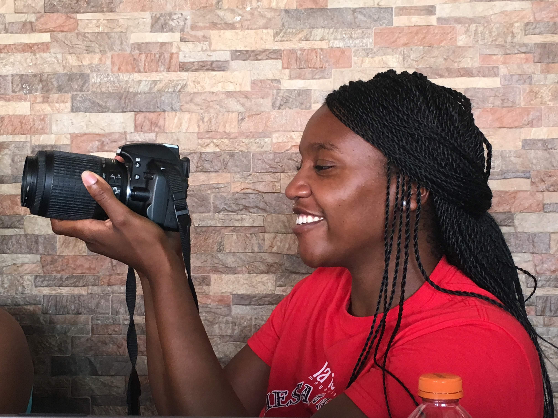
What’s next?
Understanding that cultural interaction is necessary for study abroad effectiveness
Creating opportunities within current syllabi for international exposure
Increase student integration within a community through educational immersion
Informing students that cultural diversity encompasses more than a location visit

